Slide 1
Machine Learning
CS 63
Chapter 18.1-18.3, 19.1,
skim 20.4-20.5
Adapted from slides by
Tim Finin and
Marie desJardins.
Some material adopted from notes by Chuck Dyer

Slide 2
Outline
Machine learning
  What is ML?
  Inductive learning
    Supervised
    Unsupervised
  Decision trees
  Computational learning theory

Slide 3
What is learning?
“Learning denotes changes in a system that ... enable a system to do the same task more efficiently the next time.” –Herbert Simon
“Learning is constructing or modifying representations of what is being experienced.”
–Ryszard Michalski
“Learning is making useful changes in our minds.” –Marvin Minsky

Slide 4
Why learn?
Understand and improve efficiency of human learning
  Use to improve methods for teaching and tutoring people (e.g., better computer-aided instruction)
Discover new things or structure that were previously unknown to humans
  Examples: data mining, scientific discovery
Fill in skeletal or incomplete specifications about a domain
  Large, complex AI systems cannot be completely derived by hand and require dynamic updating to incorporate new information.
  Learning new characteristics expands the domain or expertise and lessens the “brittleness” of the system
Build software agents that can adapt to their users or to other software agents

Slide 5
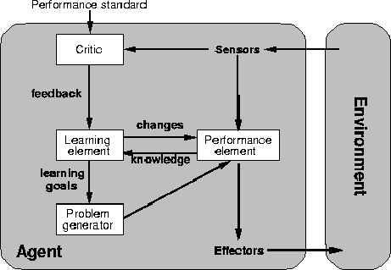
A general model of learning agents

Slide 6
Major paradigms of machine learning
Rote learning – One-to-one mapping from inputs to stored representation. “Learning by memorization.” Association-based storage and retrieval.
Induction – Use specific examples to reach general conclusions
Clustering – Unsupervised identification of natural groups in data
Analogy – Determine correspondence between two different representations
Discovery – Unsupervised, specific goal not given
Genetic algorithms – “Evolutionary” search techniques, based on an analogy to “survival of the fittest”
Reinforcement – Feedback (positive or negative reward) given at the end of a sequence of steps

Slide 7
The inductive learning problem
Extrapolate from a given set of examples to make accurate predictions about future examples
Supervised versus unsupervised learning
  Learn an unknown function f(X) = Y, where X is an input example and Y is the desired output.
  Supervised learning implies we are given a training set of (X, Y) pairs by a “teacher”
  Unsupervised learning means we are only given the Xs and some (ultimate) feedback function on our performance.
Concept learning or classification
  Given a set of examples of some concept/class/category, determine if a given example is an instance of the concept or not
  If it is an instance, we call it a positive example
  If it is not, it is called a negative example
  Or we can make a probabilistic prediction (e.g., using a Bayes net)

Slide 8
Supervised concept learning
Given a training set of positive and negative examples of a concept
Construct a description that will accurately classify whether future examples are positive or negative
That is, learn some good estimate of function f given a training set {(x₁, y₁), (x₂, y₂), ..., (x_{n}, y_{n})} where each y_{i} is either + (positive) or - (negative), or a probability distribution over +/-

Slide 9
Inductive learning framework
Raw input data from sensors are typically preprocessed to obtain a feature vector, X, that adequately describes all of the relevant features for classifying examples
Each x is a list of (attribute, value) pairs. For example,
  X = [Person:Sue, EyeColor:Brown, Age:Young, Sex:Female]
The number of attributes (a.k.a. features) is fixed (positive, finite)
Each attribute has a fixed, finite number of possible values (or could be continuous)
Each example can be interpreted as a point in an n-dimensional feature space, where n is the number of attributes

Slide 10
Inductive learning as search
Instance space I defines the language for the training and test instances
  Typically, but not always, each instance i ∈ I is a feature vector
  Features are also sometimes called attributes or variables
  I: V₁ x V₂ x … x V_{k}, i = (v₁, v₂, …, v_{k})
Class variable C gives an instance’s class (to be predicted)
Model space M defines the possible classifiers
  M: I → C, M = {m1, … mn} (possibly infinite)
  Model space is sometimes, but not always, defined in terms of the same features as the instance space
Training data can be used to direct the search for a good (consistent, complete, simple) hypothesis in the model space

Slide 11
Model spaces
Decision trees
  Partition the instance space into axis-parallel regions, labeled with class value
Version spaces
  Search for necessary (lower-bound) and sufficient (upper-bound) partial instance descriptions for an instance to be a member of the class
Nearest-neighbor classifiers
  Partition the instance space into regions defined by the centroid instances (or cluster of k instances)
Associative rules (feature values → class)
First-order logical rules
Bayesian networks (probabilistic dependencies of class on attributes)
Neural networks

Slide 12
Model spaces
I
I
-
-
-
-
+
+
+
+
I
Nearest
neighbor
-
Decision
tree
-
+
+
Version space

Slide 13
Learning decision trees
Goal: Build a decision tree to classify examples as positive or negative instances of a concept using supervised learning from a training set
A decision tree is a tree where
  each non-leaf node has associated with it an attribute (feature)
  each leaf node has associated with it a classification (+ or -)
  each arc has associated with it one of the possible values of the attribute at the node from which the arc is directed
Generalization: allow for >2 classes
  e.g., {sell, hold, buy}
Color
green
red
blue
Size
+
Shape
big
small
square
round
-
+
Size
+
big
small
-
+

Slide 14
Decision tree-induced partition – example
I
Color
green
red
blue
Size
+
Shape
big
small
square
round
-
+
Size
+
big
small
-
+

Slide 15
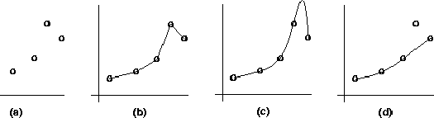
Inductive learning and bias
Suppose that we want to learn a function f(x) = y and we are given some sample (x,y) pairs, as in figure (a)
There are several hypotheses we could make about this function, e.g.: (b), (c) and (d)
A preference for one over the others reveals the bias of our learning technique, e.g.:
  prefer piece-wise functions
  prefer a smooth function
  prefer a simple function and treat outliers as noise

Slide 16
Preference bias: Ockham’s Razor
A.k.a. Occam’s Razor, Law of Economy, or Law of Parsimony
Principle stated by William of Ockham (1285-1347/49), a scholastic, that
  “non sunt multiplicanda entia praeter necessitatem”
  or, entities are not to be multiplied beyond necessity
The simplest consistent explanation is the best
Therefore, the smallest decision tree that correctly classifies all of the training examples is best.
Finding the provably smallest decision tree is NP-hard, so instead of constructing the absolute smallest tree consistent with the training examples, construct one that is pretty small

Slide 17
R&N’s restaurant domain
Develop a decision tree to model the decision a patron makes when deciding whether or not to wait for a table at a restaurant
Two classes: wait, leave
Ten attributes: Alternative available? Bar in restaurant? Is it Friday? Are we hungry? How full is the restaurant? How expensive? Is it raining? Do we have a reservation? What type of restaurant is it? What’s the purported waiting time?
Training set of 12 examples
~ 7000 possible cases

Slide 18
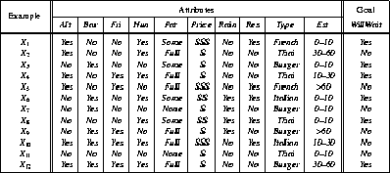
A training set

Slide 19
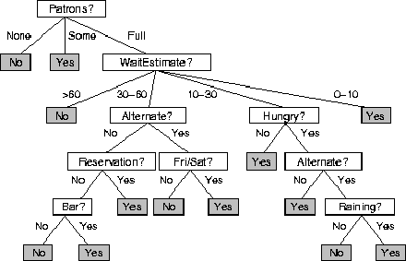
A decision tree from introspection

Slide 20
ID3
A greedy algorithm for decision tree construction developed by Ross Quinlan, 1987
Top-down construction of the decision tree by recursively selecting the “best attribute” to use at the current node in the tree
  Once the attribute is selected for the current node, generate children nodes, one for each possible value of the selected attribute
  Partition the examples using the possible values of this attribute, and assign these subsets of the examples to the appropriate child node
  Repeat for each child node until all examples associated with a node are either all positive or all negative

Slide 21
Choosing the best attribute
The key problem is choosing which attribute to split a given set of examples
Some possibilities are:
  Random: Select any attribute at random
  Least-Values: Choose the attribute with the smallest number of possible values
  Most-Values: Choose the attribute with the largest number of possible values
  Max-Gain: Choose the attribute that has the largest expected information gain–i.e., the attribute that will result in the smallest expected size of the subtrees rooted at its children
The ID3 algorithm uses the Max-Gain method of selecting the best attribute

Slide 22
Restaurant example
Patrons versus Type
French
Y
N
Y
N
Italian
Thai
N
Y
N
Y
Burger
N
Y
N
Y
Empty
Some
Full

Slide 23
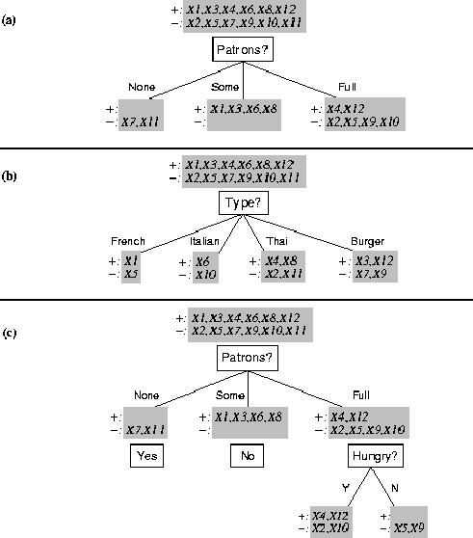
Splitting examples by testing attributes

Slide 24
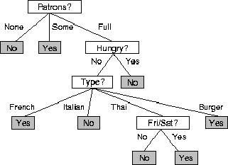
ID3-induced decision tree

Slide 25
Information theory
If there are n equally probable possible messages, then the probability p of each is 1/n
Information conveyed by a message is -log(p) = log(n)
E.g., if there are 16 messages, then log(16) = 4 and we need 4 bits to identify/send each message
In general, if we are given a probability distribution
  P = (p₁, p₂, .., p_{n})
Then the information conveyed by the distribution (aka entropy of P) is:
  I(P) = -(p₁*log(p₁) + p₂*log(p₂) + .. + p_{n}*log(p_{n}))

Slide 26
Information theory II
Information conveyed by distribution (a.k.a. entropy of P):
  I(P) = -(p₁*log(p₁) + p₂*log(p₂) + .. + p_{n}*log(p_{n}))
Examples:
  If P is (0.5, 0.5) then I(P) is 1
  If P is (0.67, 0.33) then I(P) is 0.92
  If P is (1, 0) then I(P) is 0
The more uniform the probability distribution, the greater its information: More information is conveyed by a message telling you which event actually occurred
Entropy is the average number of bits/message needed to represent a stream of messages

Slide 27
The Entropy Function Relative to Boolean Classification
1.0
Example taken from
Tom Mitchell’s
Machine Learning
Entropy
0.0
0.5
1.0
Proportion of positive examples

Slide 28
Huffman code
In 1952 MIT student David Huffman devised, in the course of doing a homework assignment, an elegant coding scheme which is optimal in the case where all symbols’ probabilities are integral powers of 1/2.
A Huffman code can be built in the following manner:
  Rank all symbols in order of probability of occurrence
  Successively combine the two symbols of the lowest probability to form a new composite symbol; eventually we will build a binary tree where each node is the probability of all nodes beneath it
  Trace a path to each leaf, noticing the direction at each node

Slide 29
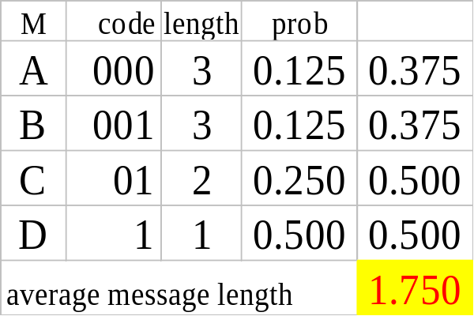
Huffman code example
Msg. Prob.
A .125
B .125
C .25
D .5
1
0
1
.5
.5
D
0
1
.25
If we use this code to many messages (A,B,C or D) with this probability distribution, then, over time, the average bits/message should approach 1.75
.25
C
0
1
.125
.125
A
B

Slide 30
So what does the Huffman code have to do with information theory?
Shannon’s entropy gives the average length of the smallest encoding theoretically possible for a weighted alphabet.
The information theoretical limit to encoding this alphabet is:
-0.5*log(0.5) – 0.25*log(0.25) – 0.125*log(0.125) – 0.125*log(0.125) = 1.75
Huffman’s code is optimal in the information theoretical sense, and yields encodings which are very very close to the theoretical limit.

Slide 31
Information for classification
If a set T of records is partitioned into disjoint exhaustive classes (C₁,C₂,..,C_{k}) on the basis of the value of the class attribute, then the information needed to identify the class of an element of T is
  Info(T) = I(P)
where P is the probability distribution of partition (C₁,C₂,..,C_{k}):
  P = (|C₁|/|T|, |C₂|/|T|, ..., |C_{k}|/|T|)
C₁
C₂
C₃
C₁
C₃
C₂
Low information
High information

Slide 32
Information for classification II
If we partition T w.r.t attribute X into sets {T₁,T₂, ..,T_{n}} then the information needed to identify the class of an element of T becomes the weighted average of the information needed to identify the class of an element of T_{i}, i.e. the weighted average of Info(T_{i}):
  Info(X,T) = Σ|T_{i}|/|T| * Info(T_{i})
C₁
C₃
C₁
C₃
C₂
C₂
High information
Low information

Slide 33
Information gain
Consider the quantity Gain(X,T) defined as
Gain(X,T) = Info(T) - Info(X,T)
This represents the difference between
  information needed to identify an element of T and
  information needed to identify an element of T after the value of attribute X has been obtained
That is, this is the gain in information due to attribute X
We can use this to rank attributes and to build decision trees where at each node is located the attribute with greatest gain among the attributes not yet considered in the path from the root
The intent of this ordering is:
  To create small decision trees so that records can be identified after only a few questions
  To match a hoped-for minimality of the process represented by the records being considered (Occam’s Razor)

Slide 34
Computing information gain
I(T) = -Σ|T_{i}|/|T| * log(|T_{i}|/|T|)
Info(X,T) = Σ|T_{i}|/|T| * Info(T_{i})
Gain(X,T) = Info(T) - Info(X,T)
French
Y
N
Italian
Y
N
Thai
N
Y
N
Y
Burger
N
Y
N
Y
Empty
Some
Full
I(T) = - (.5 log .5 + .5 log .5)
= .5 + .5 = 1
I (Patrons, T) =
1/6 (0) + 1/3 (0) +
1/2 (- 2/3 log 2/3 – 1/3 log 1/3)
= 1/2 (2/3*.6 + 1/3*1.6)
= .47
I (Type, T) =
1/6 (1) + 1/6 (1) +
1/3 (1) + 1/3 (1) = 1
Gain (Patrons, T) = 1 - .47 = .53
Gain (Type, T) = 1 – 1 = 0

Slide 35
The ID3 algorithm is used to build a decision tree, given a set of non-categorical attributes C1, C2, .., Cn, the class attribute C, and a training set T of records.
function ID3 (R: a set of input attributes,
C: the class attribute,
S: a training set) returns a decision tree;
begin
If S is empty, return a single node with value Failure;
If every example in S has the same value for C, return
single node with that value;
If R is empty, then return a single node with most
frequent of the values of C found in examples S;
[note: there will be errors, i.e., improperly classified
records];
Let D be attribute with largest Gain(D,S) among attributes in R;
Let {dj| j=1,2, .., m} be the values of attribute D;
Let {Sj| j=1,2, .., m} be the subsets of S consisting
respectively of records with value dj for attribute D;
Return a tree with root labeled D and arcs labeled
d1, d2, .., dm going respectively to the trees
ID3(R-{D},C,S1), ID3(R-{D},C,S2) ,.., ID3(R-{D},C,Sm);
end ID3;

Slide 36
How well does it work?
Many case studies have shown that decision trees are at least as accurate as human experts.
  A study for diagnosing breast cancer had humans correctly classifying the examples 65% of the time; the decision tree classified 72% correct
  British Petroleum designed a decision tree for gas-oil separation for offshore oil platforms that replaced an earlier rule-based expert system
  Cessna designed an airplane flight controller using 90,000 examples and 20 attributes per example

Slide 37
Extensions of the decision tree learning algorithm
Using gain ratios
Real-valued data
Noisy data and overfitting
Generation of rules
Setting parameters
Cross-validation for experimental validation of performance
C4.5 is an extension of ID3 that accounts for unavailable values, continuous attribute value ranges, pruning of decision trees, rule derivation, and so on

Slide 38
Using gain ratios
The information gain criterion favors attributes that have a large number of values
  If we have an attribute D that has a distinct value for each record, then Info(D,T) is 0, thus Gain(D,T) is maximal
To compensate for this Quinlan suggests using the following ratio instead of Gain:
  GainRatio(D,T) = Gain(D,T) / SplitInfo(D,T)
SplitInfo(D,T) is the information due to the split of T on the basis of value of categorical attribute D
  SplitInfo(D,T) = I(|T1|/|T|, |T2|/|T|, .., |Tm|/|T|)
where {T1, T2, ..., Tm} is the partition of T induced by value of D

Slide 39
Computing gain ratio
I(T) = 1
I (Patrons, T) = .47
I (Type, T) = 1
Gain (Patrons, T) =.53
Gain (Type, T) = 0
French
Y
N
Italian
Y
N
Thai
N
Y
N
Y
Burger
N
Y
N
Y
Empty
Some
Full
SplitInfo (Patrons, T) = - (1/6 log 1/6 + 1/3 log 1/3 + 1/2 log 1/2)
= 1/6*2.6 + 1/3*1.6 + 1/2*1
= 1.47
SplitInfo (Type, T) = 1/6 log 1/6 + 1/6 log 1/6 + 1/3 log 1/3 + 1/3 log 1/3
= 1/6*2.6 + 1/6*2.6 + 1/3*1.6 + 1/3*1.6 = 1.93
GainRatio (Patrons, T) = Gain (Patrons, T) / SplitInfo(Patrons, T) = .53 / 1.47 = .36
GainRatio (Type, T) = Gain (Type, T) / SplitInfo (Type, T) = 0 / 1.93 = 0

Slide 40
Real-valued data
Select a set of thresholds defining intervals
Each interval becomes a discrete value of the attribute
Use some simple heuristics…
  always divide into quartiles
Use domain knowledge…
  divide age into infant (0-2), toddler (3 - 5), school-aged (5-8)
Or treat this as another learning problem
  Try a range of ways to discretize the continuous variable and see which yield “better results” w.r.t. some metric
  E.g., try midpoint between every pair of values

Slide 41
Noisy data and overfitting
Many kinds of “noise” can occur in the examples:
  Two examples have same attribute/value pairs, but different classifications
  Some values of attributes are incorrect because of errors in the data acquisition process or the preprocessing phase
  The classification is wrong (e.g., + instead of -) because of some error
  Some attributes are irrelevant to the decision-making process, e.g., color of a die is irrelevant to its outcome
The last problem, irrelevant attributes, can result in overfitting the training example data.
  If the hypothesis space has many dimensions because of a large number of attributes, we may find meaningless regularity in the data that is irrelevant to the true, important, distinguishing features
  Fix by pruning lower nodes in the decision tree
  For example, if Gain of the best attribute at a node is below a threshold, stop and make this node a leaf rather than generating children nodes

Slide 42
Pruning decision trees
Pruning of the decision tree is done by replacing a whole subtree by a leaf node
The replacement takes place if a decision rule establishes that the expected error rate in the subtree is greater than in the single leaf. E.g.,
  Training: one training red true and two training blue falses
  Test: three red falses and one blue true
  Consider replacing this subtree by a single FALSE node.
After replacement we will have only two errors instead of four:
Training
Test
Pruned
Color
Color
FALSE
red
blue
red
blue
2 success
4 failure
1 true
0 false
0 true
2 false
1 true
3 false
1 true
1 false

Slide 43
Converting decision trees to rules
It is easy to derive a rule set from a decision tree: write a rule for each path in the decision tree from the root to a leaf
In that rule the left-hand side is easily built from the label of the nodes and the labels of the arcs
The resulting rules set can be simplified:
  Let LHS be the left hand side of a rule
  Let LHS' be obtained from LHS by eliminating some conditions
  We can certainly replace LHS by LHS' in this rule if the subsets of the training set that satisfy respectively LHS and LHS' are equal
  A rule may be eliminated by using metaconditions such as “if no other rule applies”

Slide 44
Evaluation methodology
Standard methodology:
  1. Collect a large set of examples (all with correct classifications)
  2. Randomly divide collection into two disjoint sets: training and test
  3. Apply learning algorithm to training set giving hypothesis H
  4. Measure performance of H w.r.t. test set
Important: keep the training and test sets disjoint!
To study the efficiency and robustness of an algorithm, repeat steps 2-4 for different training sets and sizes of training sets
If you improve your algorithm, start again with step 1 to avoid evolving the algorithm to work well on just this collection

Slide 45
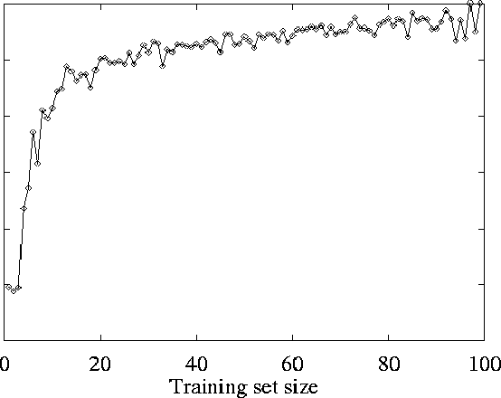
Restaurant example learning curve

Slide 46
Summary: Decision tree learning
Inducing decision trees is one of the most widely used learning methods in practice
Can out-perform human experts in many problems
Strengths include
  Fast
  Simple to implement
  Can convert result to a set of easily interpretable rules
  Empirically valid in many commercial products
  Handles noisy data
Weaknesses include:
  Univariate splits/partitioning using only one attribute at a time so limits types of possible trees
  Large decision trees may be hard to understand
  Requires fixed-length feature vectors
  Non-incremental (i.e., batch method)

Slide 47
Computational learning theory
Probably approximately correct (PAC) learning:
  Sample complexity (# of examples to “guarantee” correctness) grows with the size of the model space
Stationarity assumption: Training set and test sets are drawn from the same distribution
  Lots of recent work on what to do if this assumption is violated, but you know something about the relationship between the two distributions
Theoretical results apply to fairly simple learning models (e.g., decision list learning)

